Slide 1
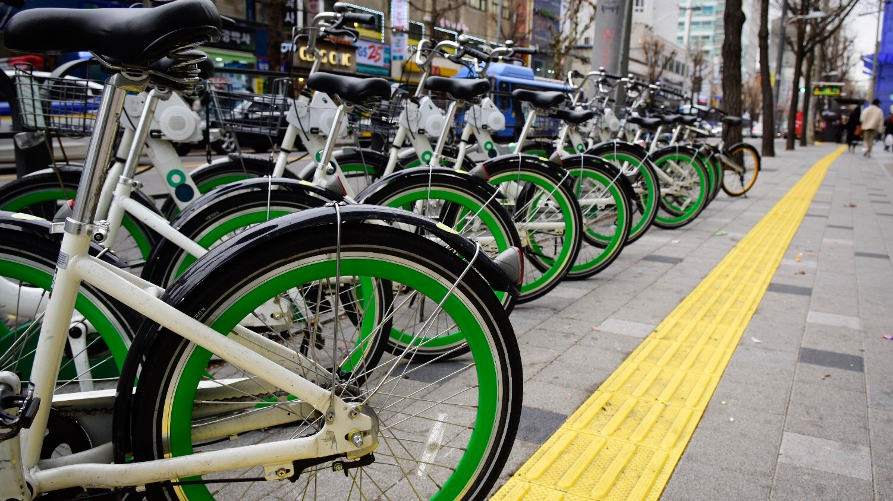

Predicting Seoul Bike Rental Demand
Miles A. Peña
June 2025
Notes:
Welcome, everyone. My name is Miles Peña, and today I’ll be presenting my project on predicting bike rental demand in Seoul. This project applies machine learning to better understand how weather and time affect urban bike usage, with the goal of improving city operations and user satisfaction.

Slide 2

Project Overview
Analyzing hourly bike rental and weather data from Seoul (2017–2018) to forecast demand and improve operational efficiency in bike-sharing systems.
Notes:
The goal of this project was to analyze hourly rental data from 2017 to 2018 and identify the key factors driving demand in Seoul’s bike-sharing system. By using predictive modeling, we can improve how bikes are distributed and when they’re made available, ultimately enhancing efficiency and reducing waste.

Slide 3

Business Problem
How can Seoul’s bike-share program optimize bike availability and reduce waste by predicting demand fluctuations based on weather and time?
Notes:
Seoul’s bike-share system faces challenges with fluctuating demand—especially during holidays, extreme weather, and commute hours. These fluctuations can lead to bikes being unavailable when needed or idle when demand is low. My question was: how can we use data to predict these patterns and plan better?

Slide 4

Data Sources & Preparation
Source: UCI Machine Learning Repository – Seoul Bike Sharing Demand Dataset
Period: 2017–2018
Features: Date, hour, temperature, humidity, solar radiation, holidays, etc.
Preprocessing: Cleaned dates, normalized weather features, created temp bands, and hourly averages
Notes:
The dataset was sourced from the UCI Machine Learning Repository and included hourly bike rentals and weather data from 2017-2018. I cleaned the date formats, normalized weather variables, and created new features like temperature bands and average hourly rentals to enrich the model.

Slide 5
Methods
EDA: Line plots, heatmaps, boxplots to understand patterns
Modeling: Random Forest, Gradient Boosting, Linear Regression
Time Series: ARIMA model
Evaluation: RMSE, MAE metrics for performance comparison
Notes:
I used a typical machine learning workflow—starting with exploratory data analysis to visualize patterns, then training multiple models like Random Forest, Gradient Boosting, and Linear Regression. I also tested ARIMA for time-series forecasting. RMSE and MAE were used to evaluate performance.

Slide 6

Key Findings
Demand spikes during commute hours
Rentals drop on holidays and extreme weather days
Warm/mild days see the highest usage
Tree-based models outperform linear ones in prediction accuracy
Notes:
A few trends emerged clearly. Rentals peak during commute hours and on mild weather days. Usage drops off during holidays and in extreme heat or cold. From a model performance perspective, Random Forest and Gradient Boosting models had the lowest error rates, outperforming simpler models.

Slide 7
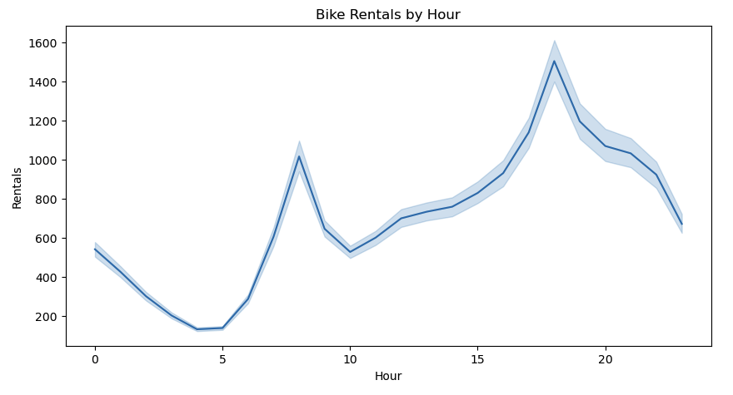
Notes:
This chart shows average bike rentals by hour. As expected, we see spikes during commute hours—around 8 a.m. and 6 p.m.—which reflects typical workday travel patterns. This reinforces the importance of aligning bike availability with peak transit times.

Slide 8
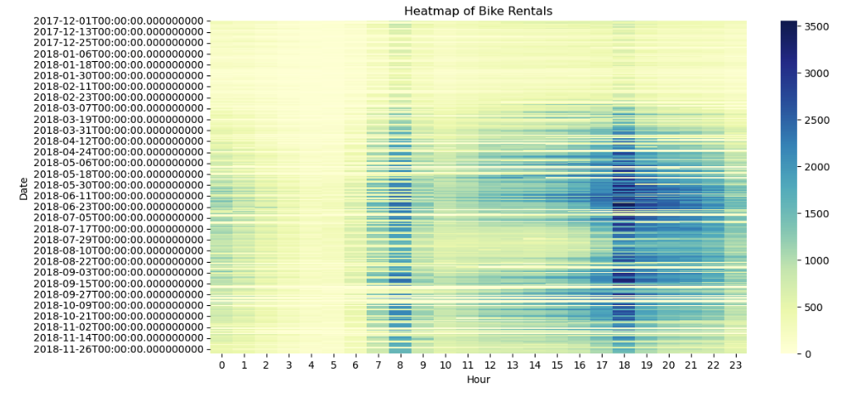
Notes:
The heatmap provides a combined view of hourly and seasonal trends. Weekdays show strong commuter usage, while weekends are more variable. Summer months tend to have higher rentals overall, but excessive heat does slightly dampen that demand.

Slide 9
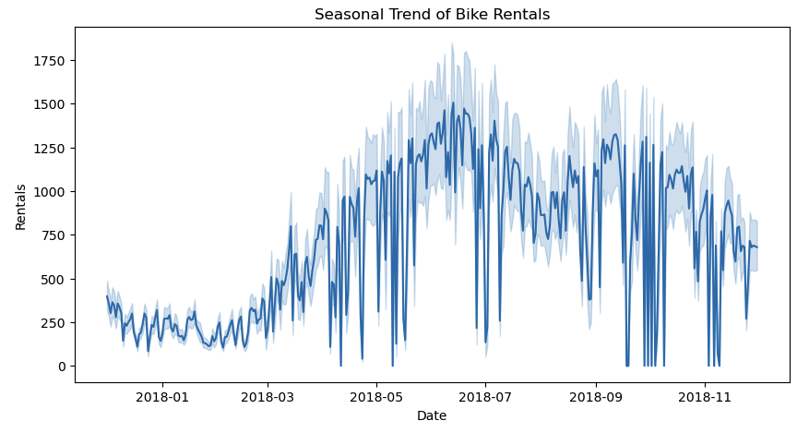
Notes:
Here we see seasonal fluctuations—spring and autumn have the highest rental volumes, while winter sees a noticeable dip. These insights can guide seasonal inventory planning and maintenance scheduling.

Slide 10
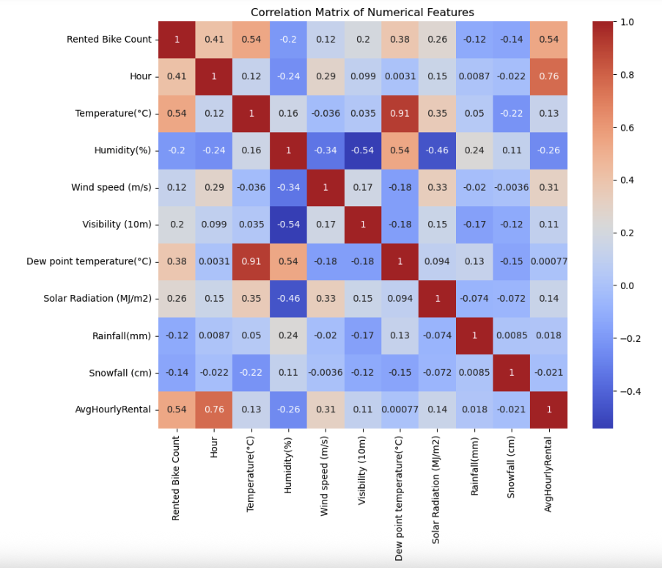
Notes:
This matrix shows the correlations between features. Temperature and solar radiation have strong positive correlations with rental count, while rainfall, snowfall, and humidity show negative correlations. This confirms our intuition and validates the inclusion of weather data in the models.

Slide 11
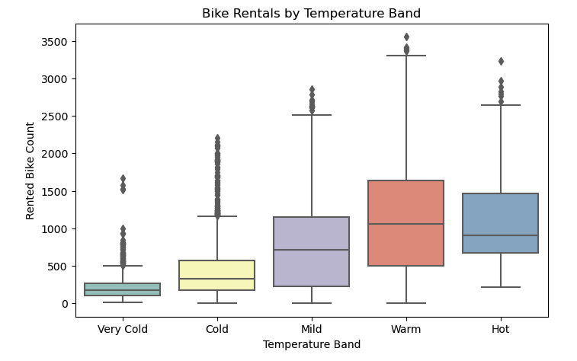
Notes:
We categorized temperatures into bands like Very Cold, Cold, Mild, Warm, and Hot. Mild and Warm bands have the highest rental counts. Very Cold and Hot days reduce ridership, likely due to comfort and safety concerns.

Slide 12
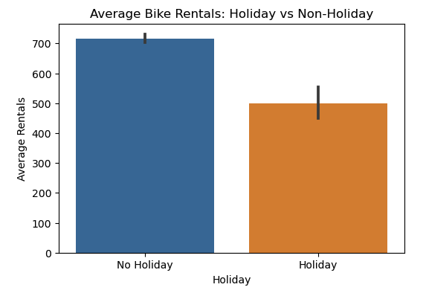
Notes:
Here we compare holidays and non-holidays. Rentals drop on holidays, which may reflect fewer commutes and more leisure-oriented travel. Planning for reduced demand on these days could help rebalance resources.

Slide 13
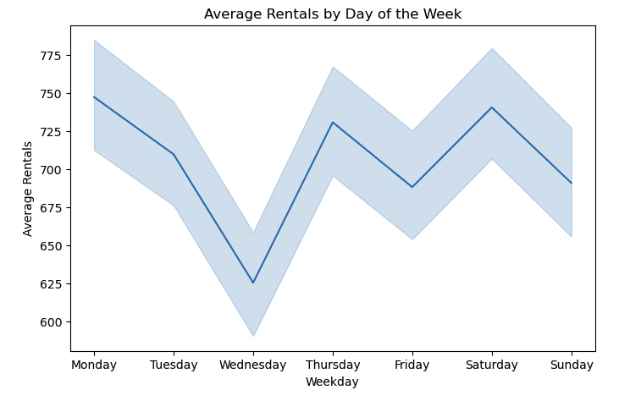
Notes:
This view breaks down demand by weekday. Mondays through Fridays show strong consistency, tied to work commutes. Weekend usage fluctuates more, possibly due to weather or events. Fridays often bridge both commuter and leisure use cases.

Slide 14
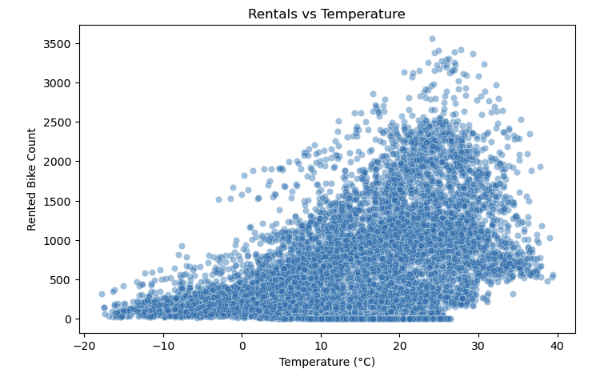
Notes:
This scatterplot reinforces the earlier trend: rentals increase with temperature up to a point, then plateau or dip once it gets too hot. This nonlinear relationship is something tree-based models like Random Forest can capture well.

Slide 15
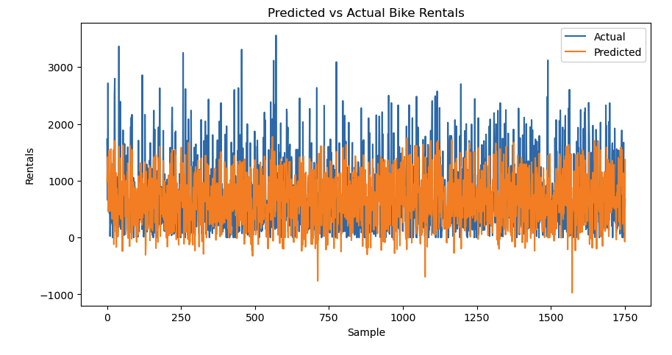
Notes:
Finally, this chart compares model predictions against actual data. As you can see, the Random Forest and Gradient Boosting models track real usage closely, demonstrating solid predictive power. Some variance still exists, especially around holidays or anomalies, but overall the models perform well.

Slide 16
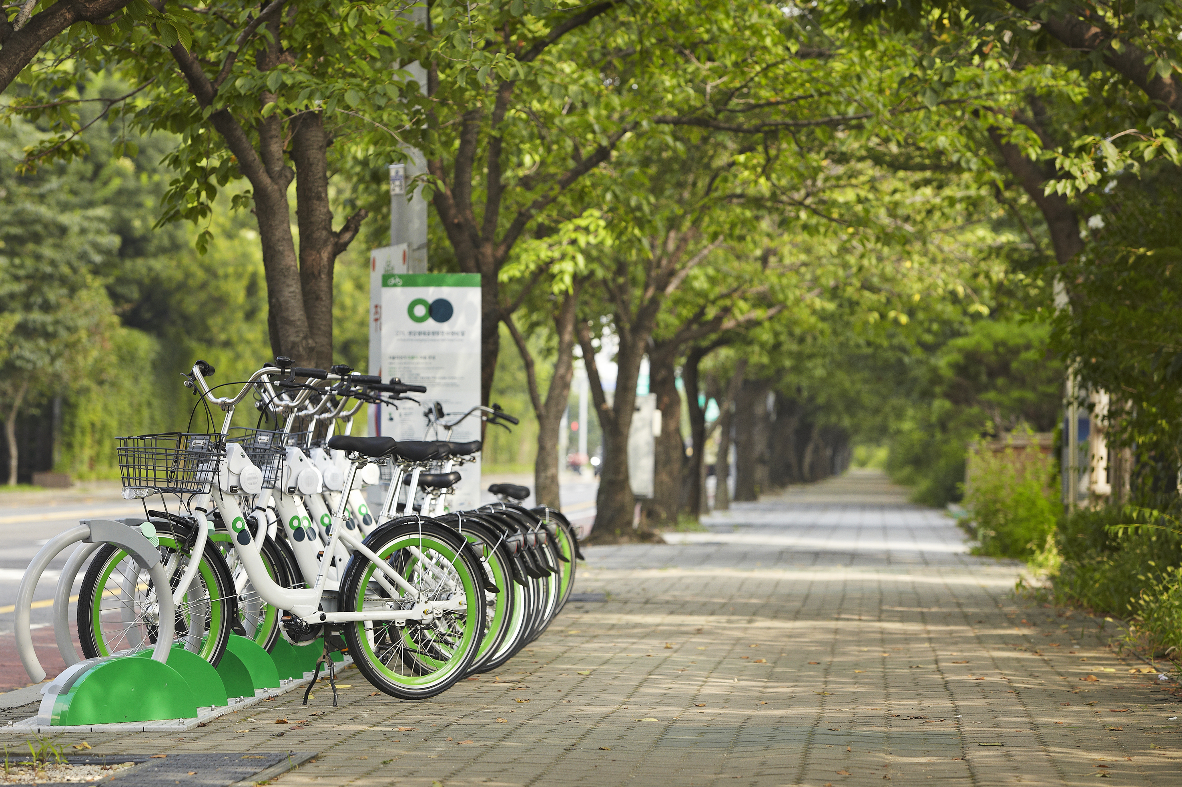
Recommendations & Applications
Build live dashboards for dispatch teams
Pair predictions with geospatial data for better routing
Retrain models weekly with new data
Integrate forecasts into rider-facing mobile apps
Notes:
Based on these insights, I recommend creating a dashboard that operations teams can use daily. This would show forecasted demand and suggest where to deploy bikes. Adding geospatial features would help pinpoint specific stations, and retraining the model weekly will keep predictions accurate.

Slide 17

Ethical Considerations
Data is anonymized and aggregate-based
Ensure models do not disadvantage low-access communities
Regular audits to prevent algorithmic bias
Notes:
Although the dataset is anonymized, it's important to ensure we’re not unintentionally reducing access in underserved areas. Bias can creep in if models only optimize for efficiency without equity. Regular reviews and transparent decision-making can help balance that.

Slide 18

Common Questions
How do models adjust for sudden weather changes?
Can this scale across districts or other cities?
How often should models be retrained?
What role could GPS or station-level data play?
Notes:
Some common questions include:
Can this scale to other cities or districts? Yes, with localized data.
Can it run in real time? With the right infrastructure, definitely.
How about unexpected weather? That’s where frequent retraining and weather APIs come in.
Would GPS or station-level data improve accuracy? Absolutely.

Slide 19
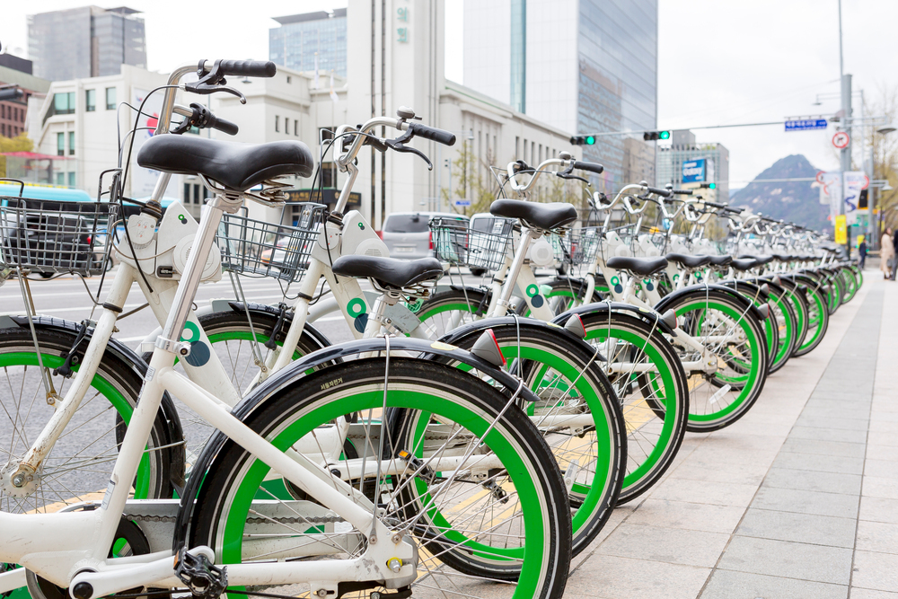

THANK YOU!
Questions? Please feel free to reach out at miles.a.pena@gmail.com
Notes:
Thank you for your time and attention.

